Slide 1

Monte-Carlo for Control
Notes:
1

Slide 2
Objectives
Estimate action-value functions using Monte-Carlo
Understand the importance of maintaining exploration in Monte-Carlo algorithms
Understand how to use Monte-Carlo methods to implement a GPI algorithm
Apply Monte-Carlo with exploring starts to solve an MDP .
Monte-Carlo for Control
2
Notes:
2

Slide 3
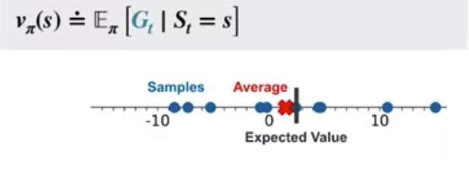
Monte-Carlo for Action Value
Learning action values is almost exactly the same process as learning state values.
We learned the value of a state by averaging sample returns from that state
Monte-Carlo for Control
3
Notes:
3

Slide 4
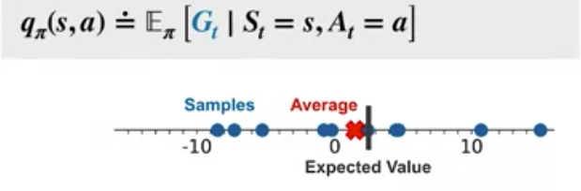
Monte-Carlo for Action Value
The same process works for action values.
We collect returns following a policy from state-action pair and then take their average
Monte-Carlo for Control
4
Notes:
4

Slide 5
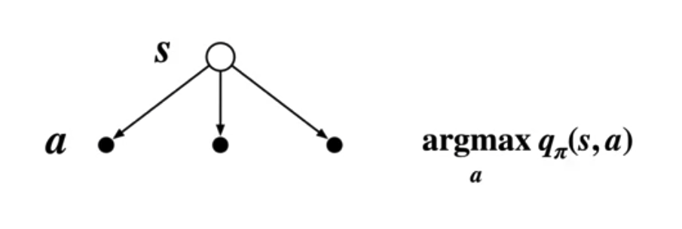
Monte-Carlo for Action Value
Action values are useful for learning a policy
They allow us to compare different actions in the same state. Then, we can switch to a better action if one is available.
Monte-Carlo for Control
5
Notes:
5

Slide 6
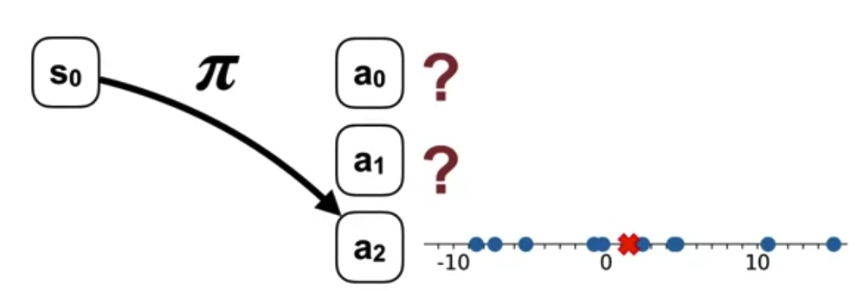
Monte-Carlo for Action Value
Let's consider learning the action-value function for a deterministic policy.
Imagine an action that is never selected by the policy.
The agent will never observe returns corresponding to that action. We won't be able to form an accurate Monte Carlo estimate.
Monte-Carlo for Control
6
Notes:
6

Slide 7
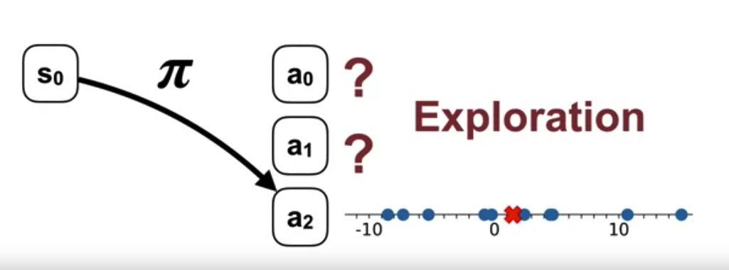
Monte-Carlo for Action Value
The agent must try all the actions in each state in order to learn their values. This is the problem of maintaining exploration in reinforcement learning.
Monte-Carlo for Control
7
Notes:
7

Slide 8
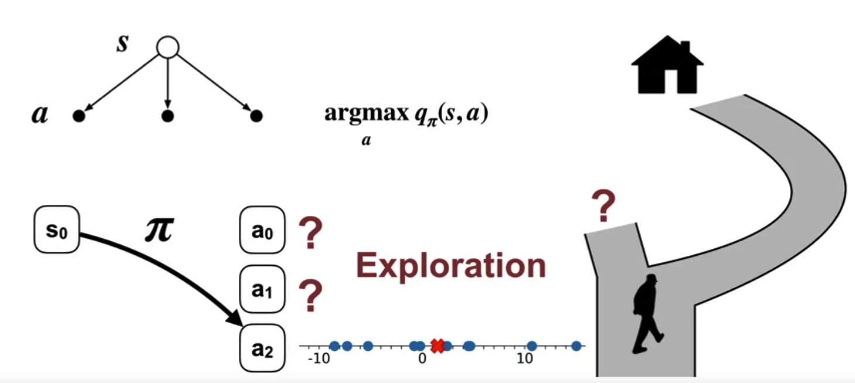
Monte-Carlo for Action Value
Real-world example. Imagine walking home along the road you usually take. Recently, a new road was built nearby. If we don't ever try the new way, then we couldn't know if it was actually better
Monte-Carlo for Control
8
Notes:
8

Slide 9
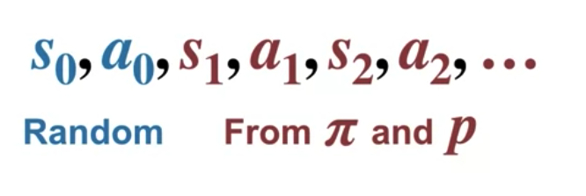
Monte-Carlo for Action Value
Exploring starts.
This is a way to maintain exploration.
In exploring starts, we must guarantee that episodes start in every state-action pair.
Afterwards, the agent simply follows its policy.
Monte-Carlo for Control
9
Notes:
9

Slide 10
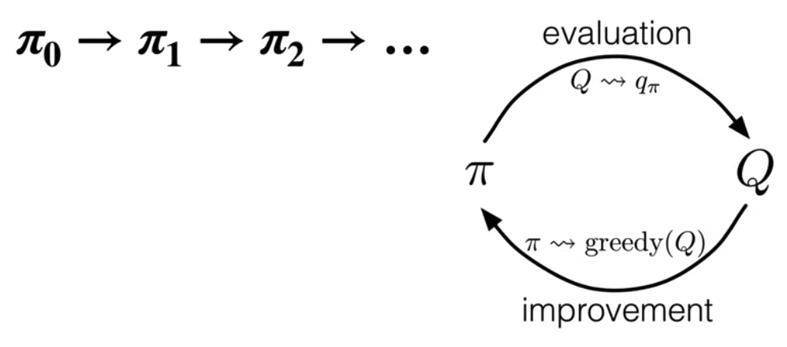
Monte-Carlo for Generalized Policy Iteration
GPI includes a policy evaluation and a policy improvement step.
GPI algorithms produce sequences of policies that are at least as good as the policies before them
Monte-Carlo for Control
10
Notes:
10

Slide 11
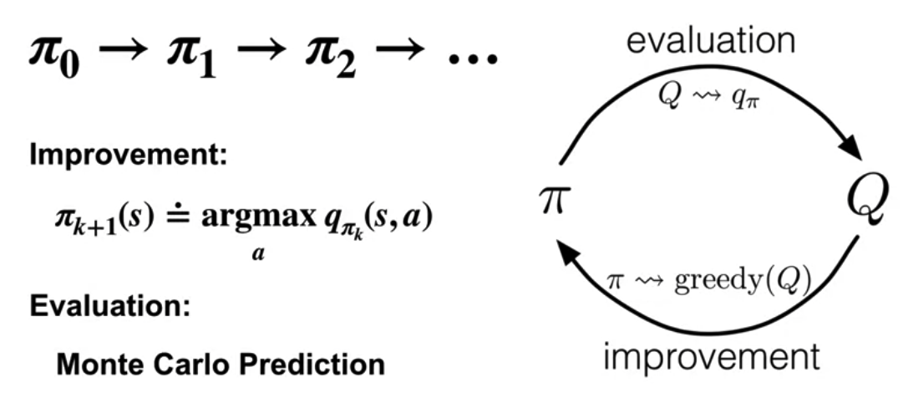
Monte-Carlo for Generalized Policy Iteration
For the policy improvement step, we can make the policy greedy with respect to the agent's current action value estimates.
For the policy evaluation step, we will use a Monte Carlo method to estimate the action values.
Monte-Carlo for Control
11
Notes:
11

Slide 12
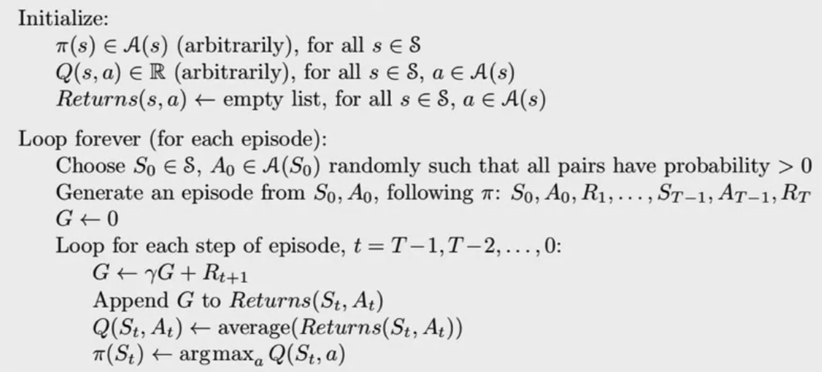
Monte-Carlo for Generalized Policy Iteration
Monte Carlo method for learning action values
Monte-Carlo for Control
12
Notes:
12

Slide 13
Blackjack Example
We will train our agent to play blackjack using Monte Carlo with Exploring Starts.
Exploring starts requires that episodes begin with a random state and action.
Our version of blackjack naturally starts in random states. Then, all we have to do is to randomly select the first action in each episode. --> the agent ignores what it thinks is the best action in the first state and randomly chooses to hit or stick.
Monte-Carlo for Control
13
Notes:
13

Slide 14
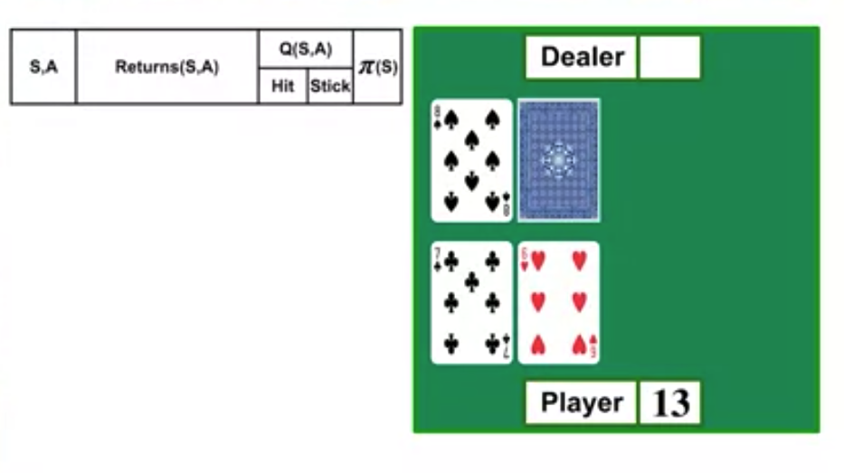
Blackjack Example
The initial policy is hit, when the agent sum is less than 20, and to stick when the sum is 20 or 21.
Suppose the agents cards show a total of 13 with no usable ace and the dealers visible card is an eight.
Monte-Carlo for Control
14
Notes:
14

Slide 15
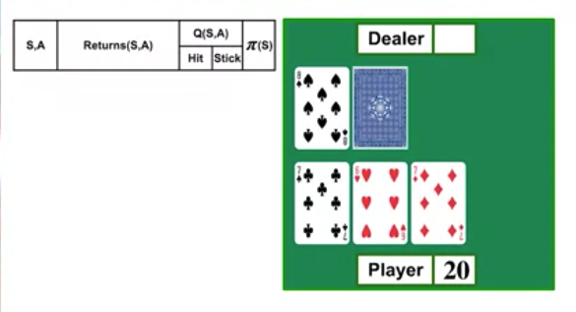
Blackjack Example
According to the randomly sampled first action, the agent hits.
The agent gets a seven moving the sum to 20.
The next step, the agent chooses the action according to its policy. --> it sticks
Monte-Carlo for Control
15
Notes:
15

Slide 16
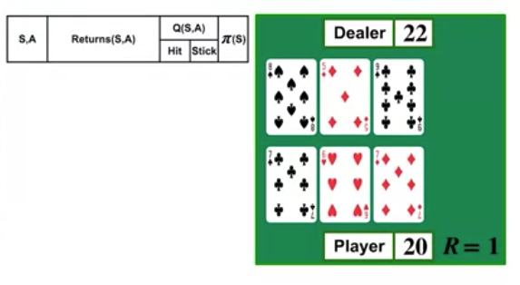
Blackjack Example
The dealer draws a nine and goes over 21 losing the game and resulting in a plus one reward for the agent.
Monte-Carlo for Control
16
Notes:
16

Slide 17
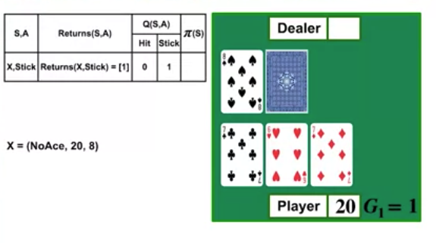
Blackjack Example
In the last non-terminal state, the agent had a sum of 20, no usable ace, and the dealer had an eight.
From that state, the agent chose to stick.
The agent adds plus one to its list of returns corresponding to that state action pair.
The estimated value for the action stick in this state is simply one.
Monte-Carlo for Control
17
Notes:
17

Slide 18
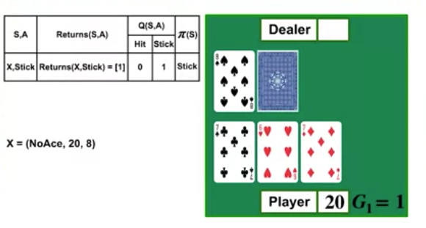
Blackjack Example
Let's look at the value of the two actions in this state.
The agent never tried to hit action, so its value is zero.
The value of the stick action is one. So the greedy action with respect to Q, in this state, is to stick.
It has the highest estimated value.
Monte-Carlo for Control
18
Notes:
18

Slide 19
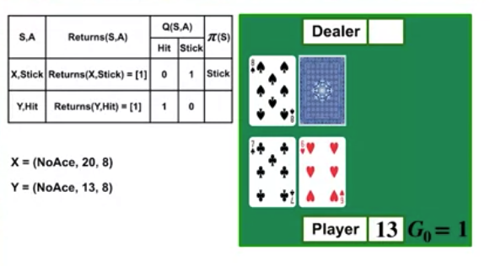
Blackjack Example
One more step to the start state.
The agent had 13 with no usable ace, and the dealer had an eight.
The randomly chosen action was to hit. → the agent adds plus one to the list of returns following that state action pair.
The average of the list forms the estimate of the action value.
Monte-Carlo for Control
19
Notes:
19

Slide 20
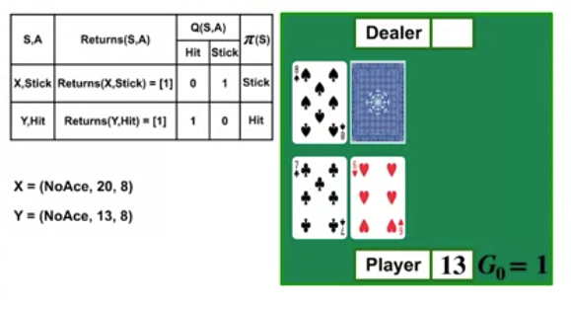
Blackjack Example
Finally, the policy is updated in this state to be greedy with respect to the action value estimates.
In this state, we had never tried to stick action and its value is zero.
But the hit action resulted in a return of one.
So the greedy action is to hit, and the policy is updated to reflect this.
Monte-Carlo for Control
20
Notes:
20

Slide 21
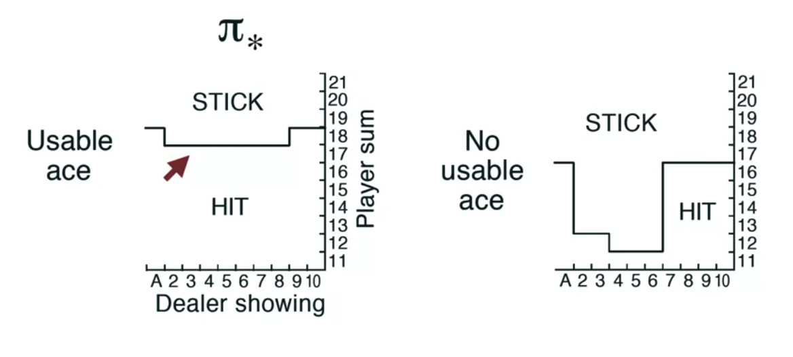
Blackjack Example
The optimal policy that the agent found after we ran it for a really long time.
Notice how the agent plays when it has the usable ace.
For most dealer cards, the agent hits until it has the sum near 19.
With a usable ace, the agent has a lot more flexibility in calculating the sum of its cards, so the policy is much more aggressive.
Monte-Carlo for Control
21
Notes:
21

Slide 22
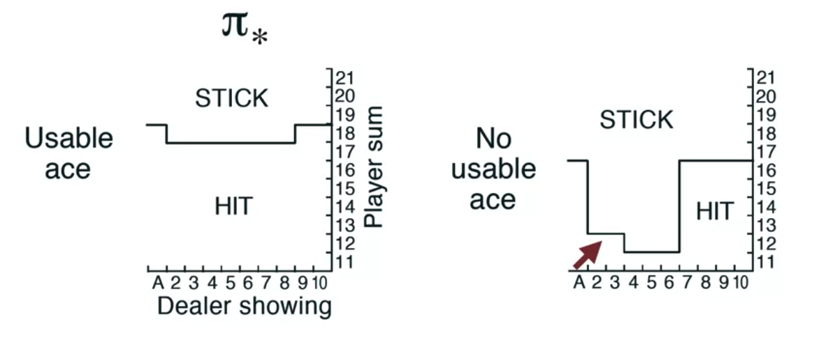
Blackjack Example
Without a usable ace, the policy depends a lot more on the cards the dealer is showing.
The agent sticks when its sum is 13 or greater and the dealer has a low card, like a two or three.
Monte-Carlo for Control
22
Notes:
22

Slide 23
Summary
Estimate action-value functions using Monte-Carlo
Understand the importance of maintaining exploration in Monte-Carlo algorithms
Understand how to use Monte-Carlo methods to implement a GPI algorithm
Apply Monte-Carlo with exploring starts to solve an MDP .
Monte-Carlo for Control
23

Slide 24
Q & A
Monte-Carlo for Control
24

